Slide 1

SUCCESSIVE APPROXIMATION REGISTER ADC
ENDSEM Presentation
BY
YASH (2021A8PS3049G)
UNDER THE SUPERVISION OF
DR. APURBA CHAKRABORTY

Slide 2
INTRODUCTION TO SAR ADC
The SAR ADC is an attractive solution in low power application, it offers a good compromise between medium resolution, speed and low power consumption.
SAR ADCs uses binary search algorithm in a feedback system.
They don’t require power hungry analog circuits like opamps neither do they uses a large number of comparators for other ADCs.
The power efficiency is useful for systems that require a large number of ADCs.
Useful for speeds around a few KHz to MHz

Slide 3
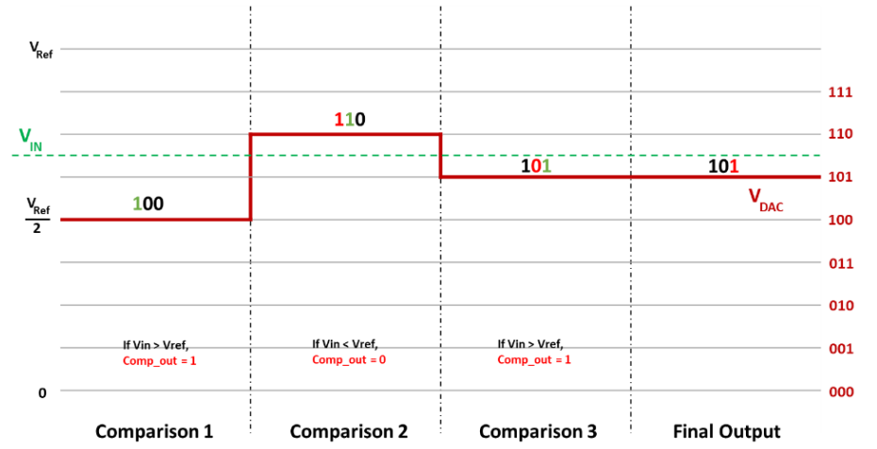
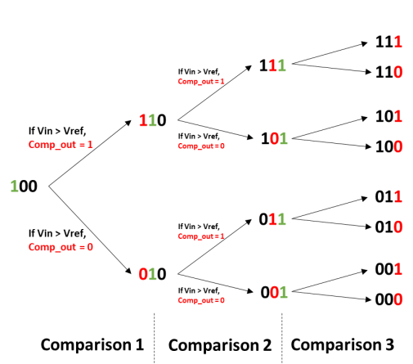
WORKING PRINCIPLE

Slide 4
TWO STAGE COMPARATOR
Comprises a preamp stage and a regenerative latch. The preamp stage isolates the input nodes from the output stage, reducing input-referred offset and kickback noise.
Offers an extra gain stage, improving sensitivity and accuracy in high-resolution systems.
During the reset phase, the RS latch stores the decision for SAR logic, maintaining stability while the strong-arm latch resets.
The XOR gate generates a ready signal to indicate the completion of the comparison process.
Operation of Strong-Arm Latch
Reset Phase (clk = 0): Tail current is off, and the output nodes are pulled high to VDD.
Regeneration Phase (clk = 1): Back-to-back inverters activate, creating a positive feedback loop. Output nodes differentiate, with one pulled to ground and the other to VDD.
The RS latch ensures the outputs remain stable during reset, and the XOR gate confirms the completion of regeneration by signaling when outputs differ.

Slide 5
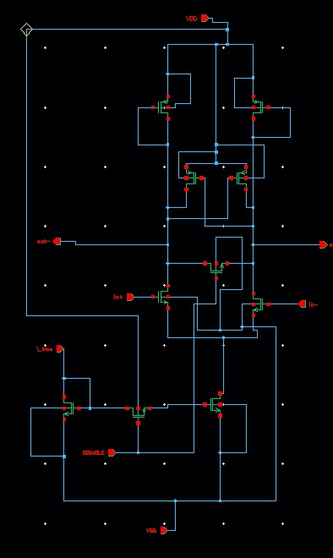
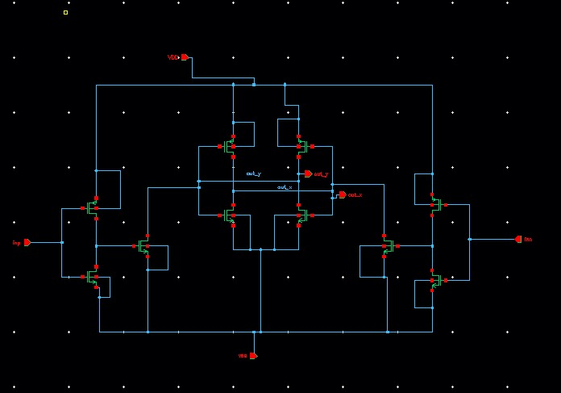

Slide 6
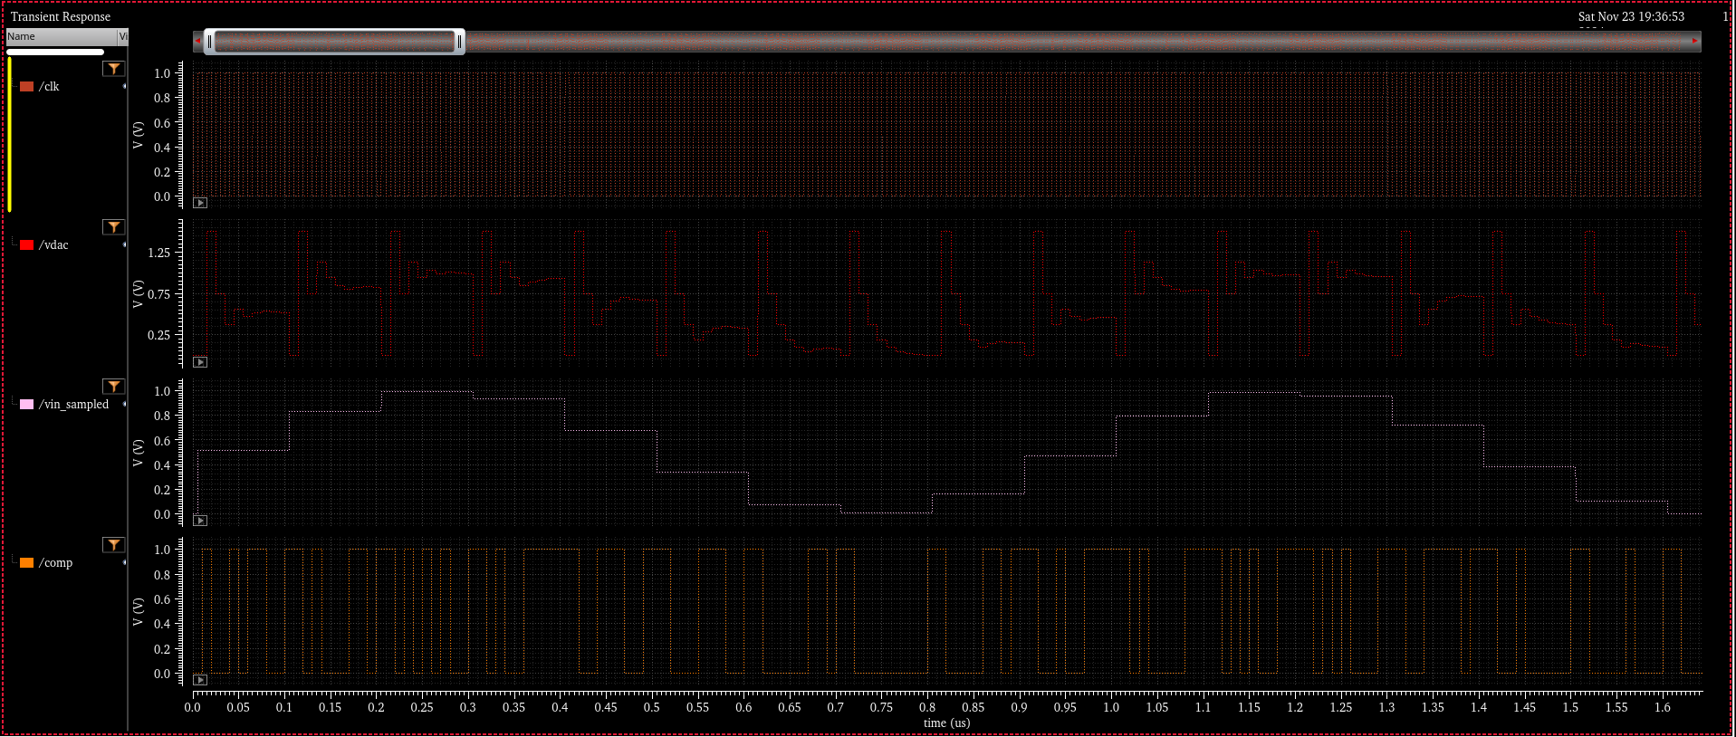

Slide 7
SAMPLE AND HOLD
The sample-and-hold circuit is basically a switch that captures the value of an analog signal at a certain moment and holds it constant for a certain amount of time.
In most circuit implemented using NMOS and PMOS, but they have some non idealities that affect the quality of the sampled signal.
The bootstrapped switch help mitigate some of these non-idealities by keeping the VGS of the switch fixed during the sampling phase.
Switching Mechanism
Mn1, Mp1, Mn2, and Mp2 act as switches to charge the offset capacitor during the hold phase.
A larger COFFSET maintains a constant Vc during sampling but increases area usage.
Clock feedthrough cancellation is achieved by adding MpSW parallel to MnSW, operating with opposing clocks (clk and clk_b).

Slide 8
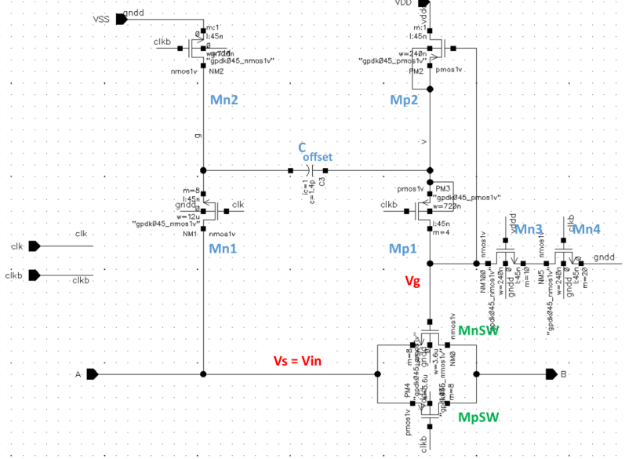
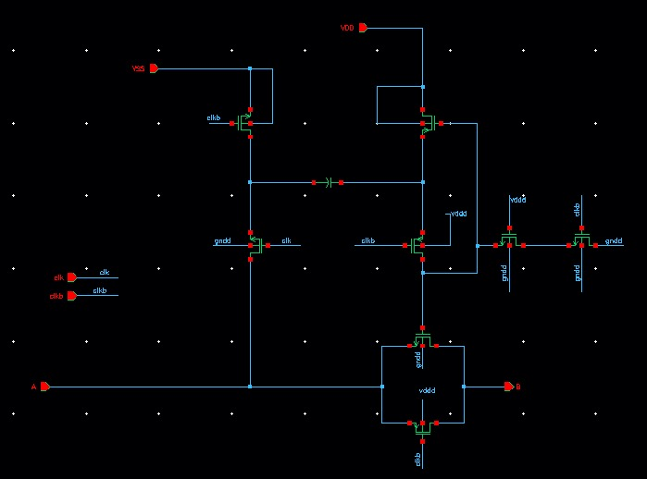

Slide 9
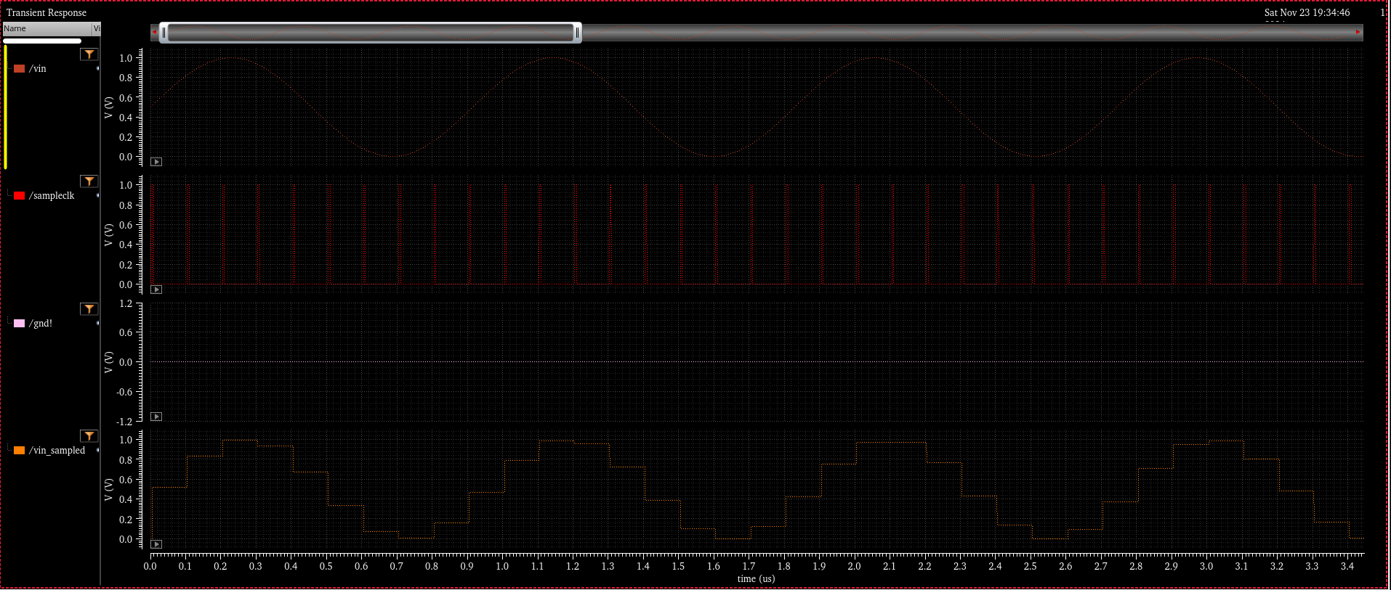

Slide 10
SAR LOGIC
Structure of SAR Logic
Composed of two rows of DFF:
Sequence registers: Tracks the conversion sequence using a one-hot-code.
Code register: Stores the final DAC code after conversion.
Operation of Sequencer Register
Works like a ring counter, circulating a "hot code" (1) through the flip-flops at each clk SAR rising edge.
The "hot code" sets the corresponding bit for comparison by triggering the set input of the matching FF in the code register.
Code Register Functionality
When a bit in the code register is set, it outputs a 1 for its corresponding bit.
End of Conversion (EOC) Signal
At the end of the conversion, the code register holds the final DAC code.
An EOC signal indicates the ADC conversion is complete, sending the result to the output stage.

Slide 11
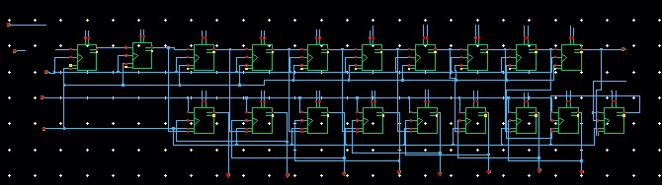
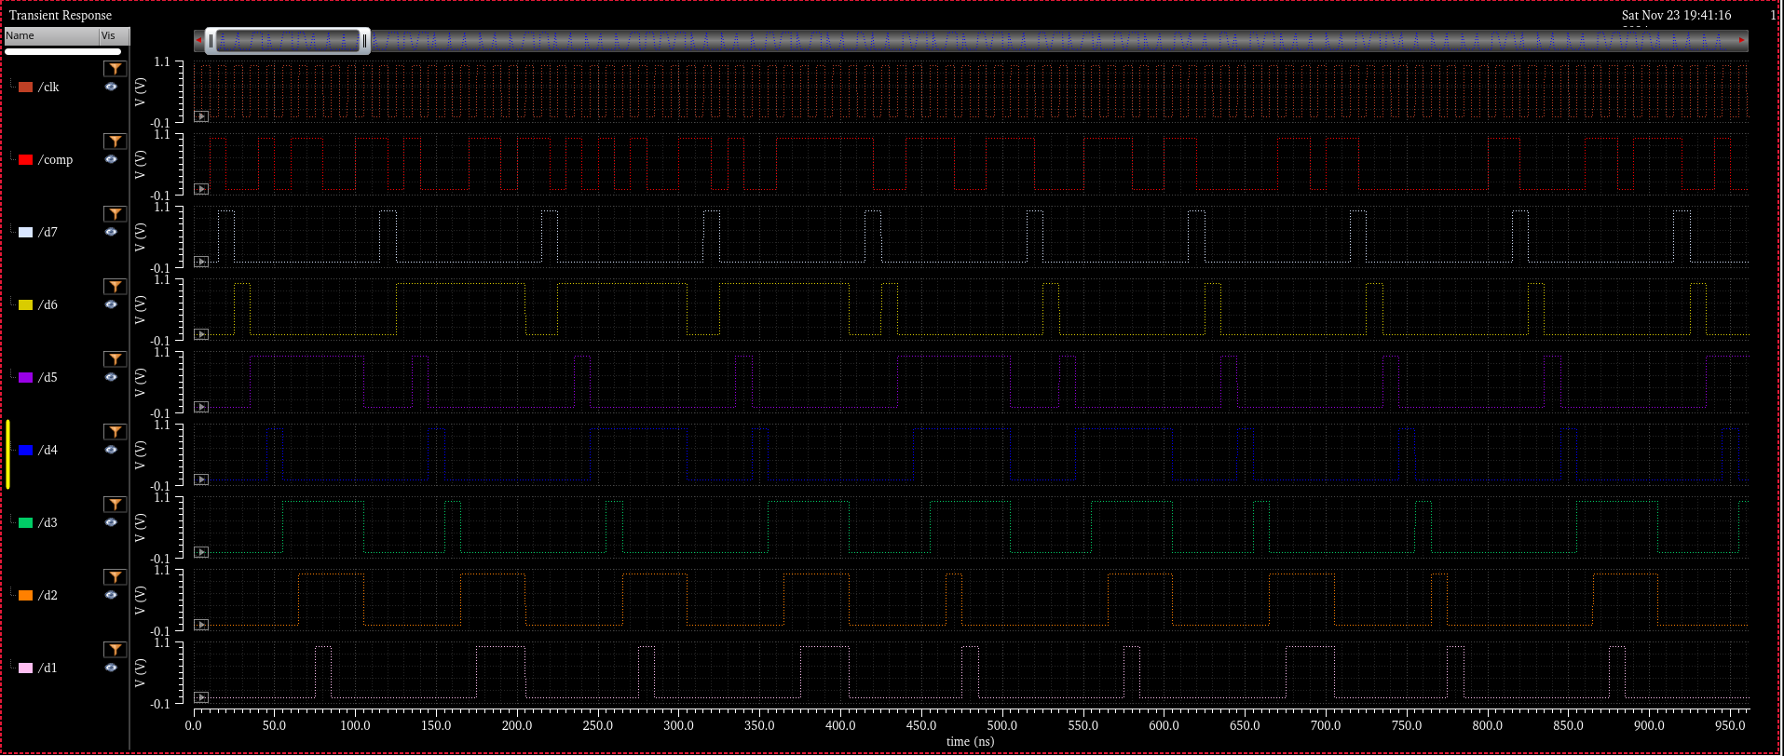

Slide 12
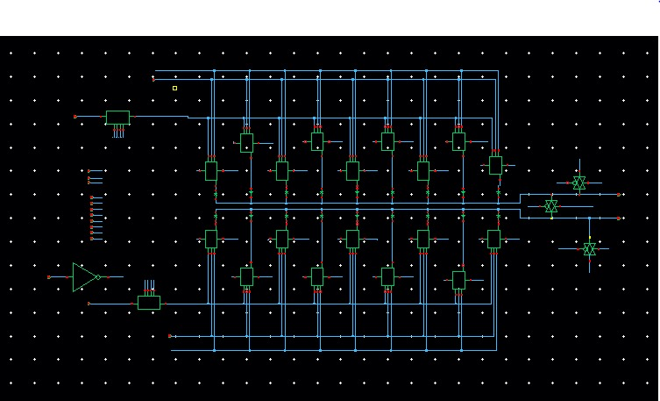
CAPACITIVE DAC
Primary Function of the DAC
Converts digital codes from the SAR logic into corresponding analog voltage levels.
Outputs are compared by the comparator during the SAR ADC operation.
Conventional Capacitive DAC
Uses charge redistribution with an array of N binary-weighted capacitors and a dummy capacitor.
Design Trade-offs
Increasing transistor widths lowers ON resistance (RON) but increases parasitic capacitances.

Slide 13
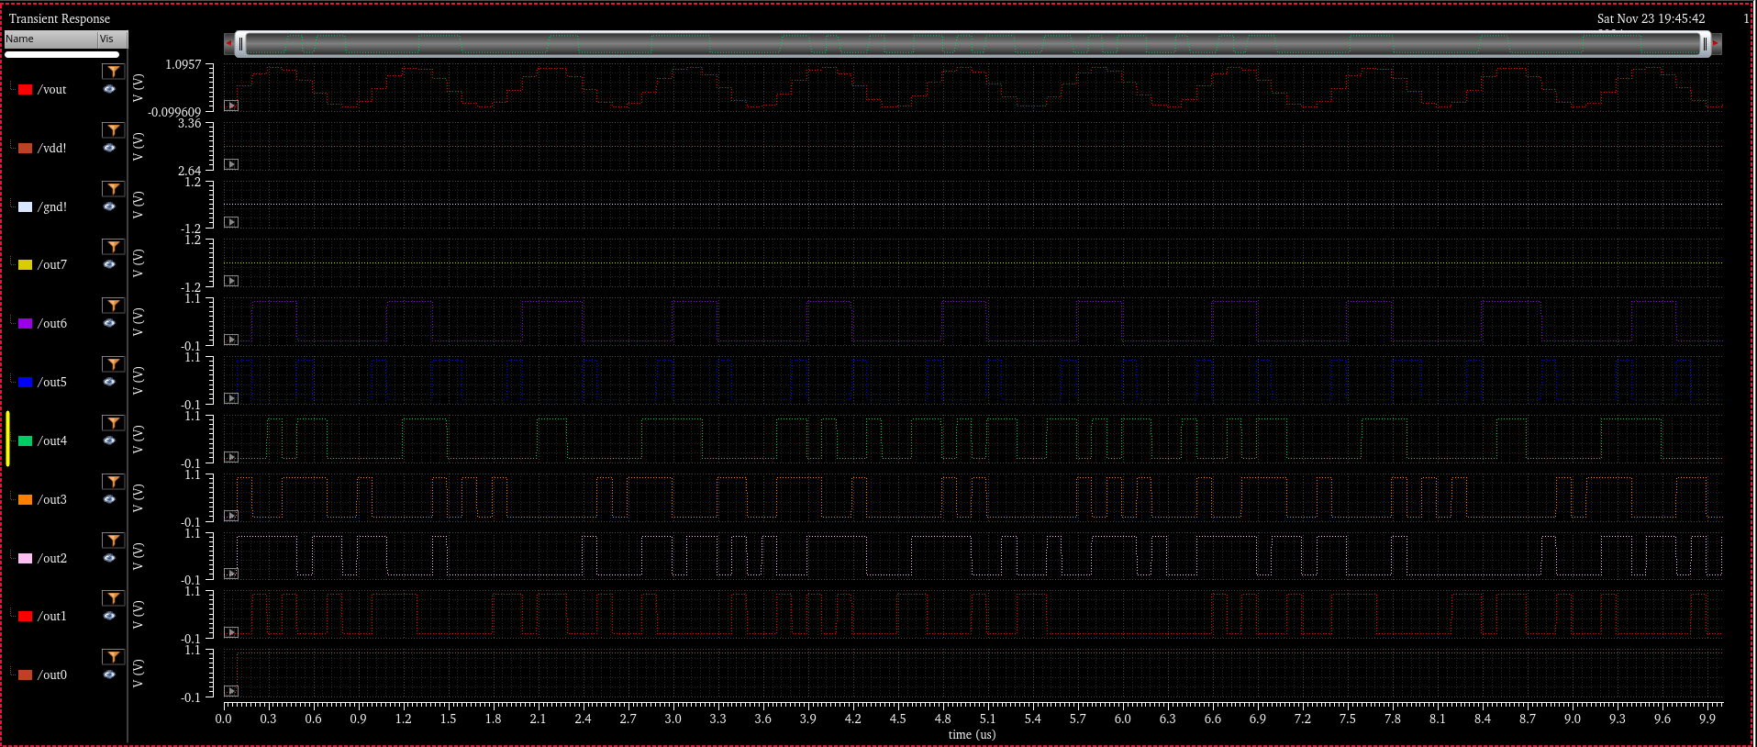

Slide 14
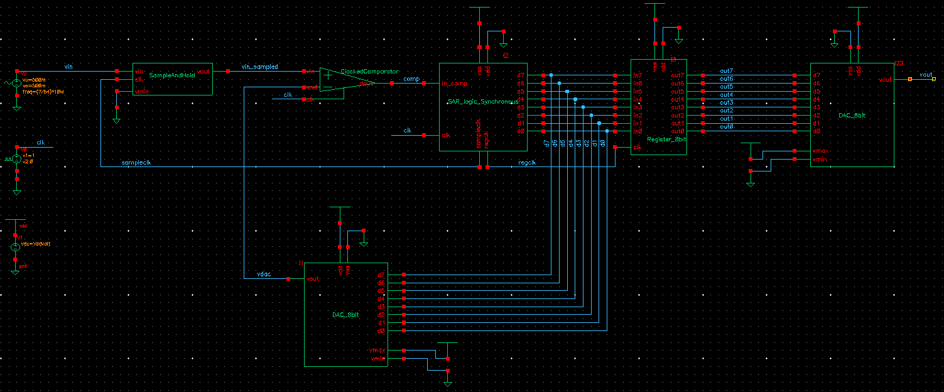

Slide 15
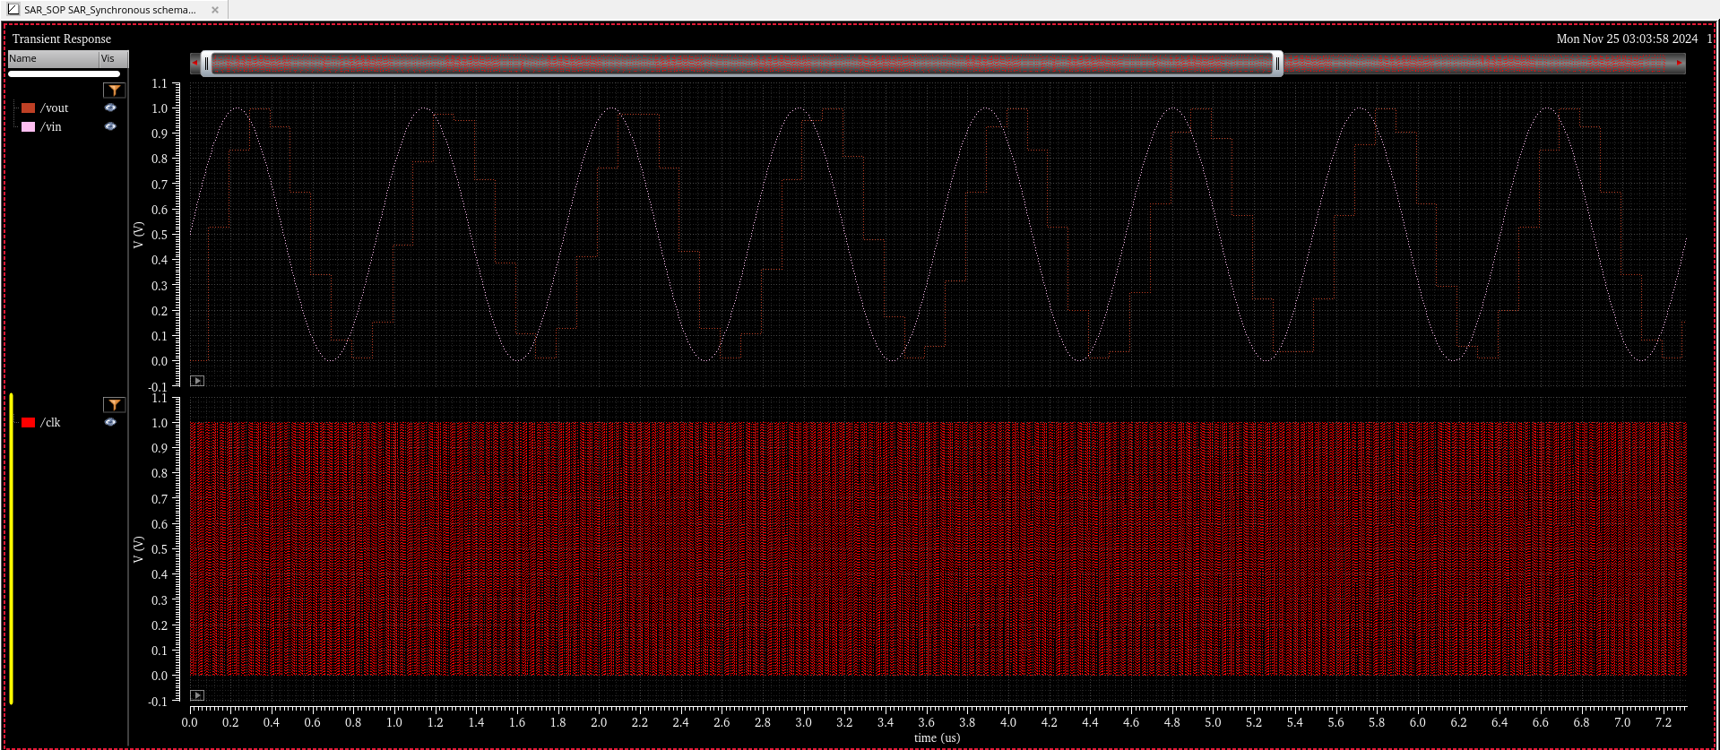

Slide 16
THANK
YOU

